Slide 1
Sample-Efficient Learned Self-Driving through a Variational Autoencoder
Manav Gagvani
Computer Systems Research 2023-24
Notes:
Hello, my name is Manav Gagvani.
Today I will be presenting on my senior research project, “Sample-Efficient Learned Self-Driving through a Variational Autoencoder”
Let’s get started!

Slide 2
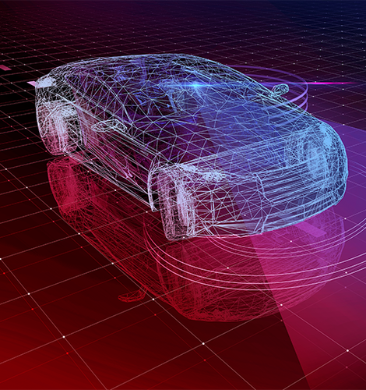
Agenda
Problem Statement
Reinforcement Learning Basics
Making Reinforcement Learning More Efficient
Construction of 1/10 Scale Autonomous Car
Real-World Autonomous Vehicle Experiments
Notes:
Here’s the plan for today’s presentation
Starting with problem statement, I’ll discuss reinforcement learning
Then I’ll transition into discussing the other component of my project
Which was building a 1/10 scale autonomous car

Slide 3
Problem Statement
UN estimates that there are 1.19 million traffic-related deaths worldwide
Resultant $1.8 trillion loss to the global economy.
94% of these deaths are a result of human error.
The solution to these problems is fully autonomous vehicles (AVs). However, current methods of training autonomous vehicles are insufficient for learning to drive safely with limited data.
Notes:
My project is about making better self-driving cars
But why do we even need self driving cars
Well, UN estimates over a million traffic deaths
Almost $2 trillion lost because of this
The National Highway Traffic Safety Administration estimates 94% of traffic deaths are a result of human error.
Thus, autonomous vehicles can solve this problem.

Slide 4
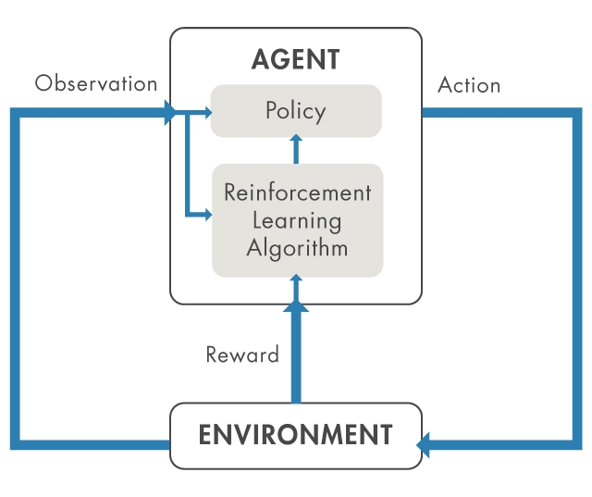
Reinforcement Learning
Agent acts in an environment
Receives rewards for performing actions
The RL algorithm takes observations from the agent to inform its policy to maximize reward
Notes:
How do we teach a car to drive itself?
Conventional machine learning approaches are known as supervised learning
A data-set is recorded by an expert (human driver), and then a model is trained/deployed based on that data
But there is a way to have the AI model continuously learn from experience – this is known as reinforcement learning
To understand RL in the context of supervised learning, think of it as updating the model with one individual data point in real-time

Slide 5
Reinforcement Learning, Applied to autonomous Vehicles
Agent: The car itself
Environment: The road
Observations: Sensor Data
Camera images
LiDAR (distance) measurements
Acceleration, velocity
Reward Function:
Stay close to the centerline of the road
Avoid crashing into obstacles
Keep velocity within minimum and maximum bounds
Further objectives, e.g. “minimize jerk”
Notes:
How can we apply reinforcement learning to autonomous vehicles?
In the case of AVs the agent is the car itself, acting on the road
Its observations consist of sensor data: including camera images, lidar measurements, and spatial information such as position, velocity, and acceleration
In this project I will focus on the sole observation being pictures from a front-facing camera looking down at the road
The reward function is designed to mimic what a human driver would emphasize
Staying in the center of the lane, avoid crashing, keeping a reasonable velocity

Slide 6
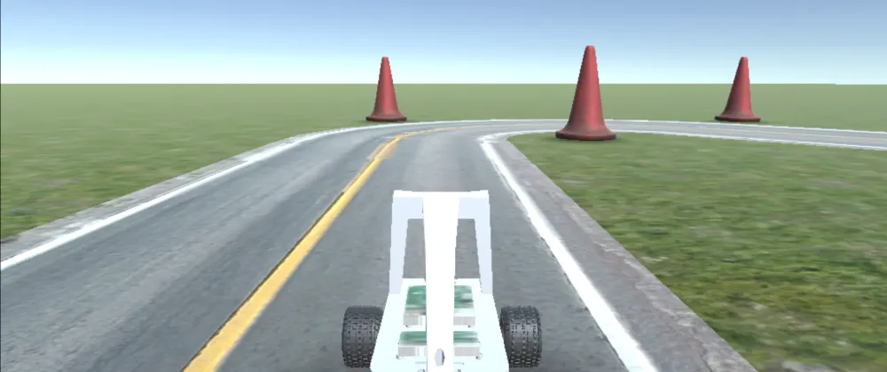
Self-Driving Car Simulation
Unity simulation of 1/10 scale car
Kinematic model
Provides camera images, collision data through standardized OpenAI Gym API
Useful for Reinforcement Learning
Notes:
To experiment and prototype reinforcement learning algorithms, start with a simulation
Remember, the car will be collecting data as it goes, and in the beginning the policy will be nowhere close to optimal
So it’ll crash a lot. Don’t want to do that with a real car, it would be a disaster.
Thus, I used an open-source Unity simulation of 1/10 scale racecars.
It implements the kinematic bicycle model to properly simulate the motion of these cars. All real cars use a set of linkages called Ackermann steering geometry.
The simulation outputs camera images from the perspective of the car, and important data such as simulated distance measurements, position, velocity, and collisions
Also, it implements a standard interface created by OpenAI, called OpenAI gym
In general, OpenAI gym is used to simulate physical models, like cars in this example. Another example is balancing on a pogo stick.
Gym implements specific standardized methods which each environment can implement. This makes it easy to plug and play reinforcement learning algorithms to experiment.

Slide 7
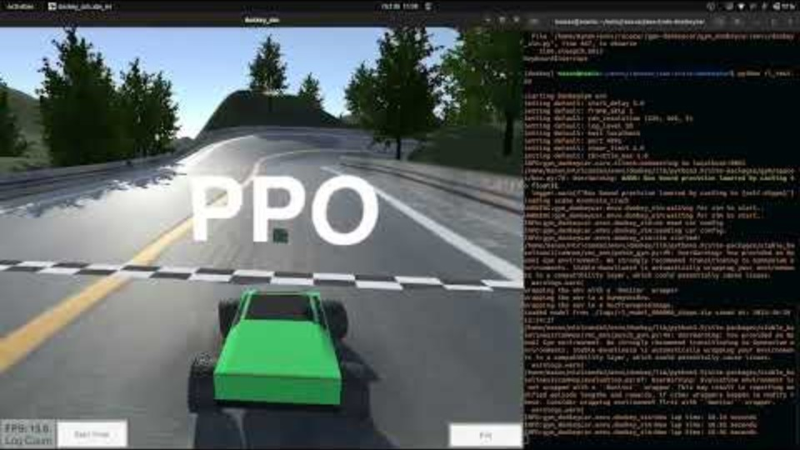
Basic reinforcement learning in simulation
PPO (Proximal Policy Optimization) algorithm (a well-known baseline algorithm in RL)
Input is raw image from front camera
Goal is to learn steering and throttle outputs
Minimize distance from centerline, travel faster than minimum velocity
Notes:
First try at reinforcement learning was using well known algorithm called Proximal Policy Optimization (PPO)
PPO is well suited for continuous action spaces, like driving a car where steering and throttle can be any values within specific boundaries
Method of choice currently for reinforcement learning
The basic idea of the algorithm is that it estimates how much better the reward for each state-action pair is compared to the average reward
(Play video)
Note that the car is very wobbly – since the PPO algorithm doesn’t consider actions from the past, only the present.
However, it does do a good job of following the yellow centerline

Slide 8
Basic reinforcement learning in simulation
This policy took 48 hours to train. The simulation was sped up to 4x real-time.
Notes:
Big problem – this is nice, but it took forever to train (48 hours).
And since it was sped up 4x, this was 8 days of training continuously. Each time getting a little farther along the track.
And thousands of crashes. Clearly not feasible for a real car.

Slide 9
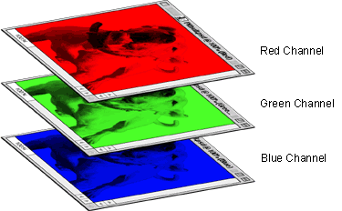
More useful Data?
Problem: Images are large.
640 * 480 * 3 = 921600 values
How to reduce observation space of the car so that it can learn more efficiently?
Notes:
Why did it take so long to train?
There are 300,000 pixels. Each with 3 different channels, red, green and blue.
So 921,600 numbers in total, each with 256 possible values. Amount of different observations is huge.
Considering each image of the road is slightly different, the model has to account for these small variations
But at the end of the day, we want the reinforcement learning policy to give the same action for all road images which are curved the same way

Slide 10
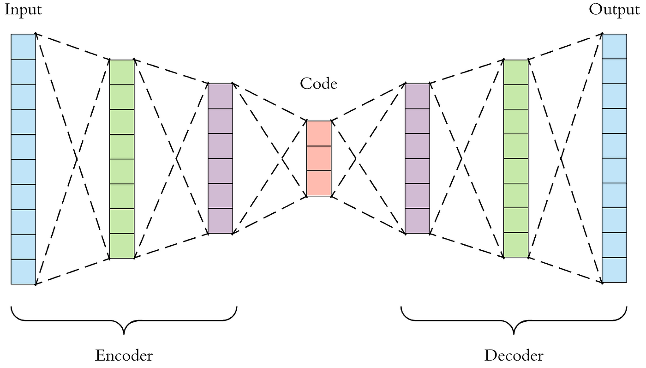
Autoencoders - Finding a Latent Representation
Create an encoder network that encodes a latent representation of the input
Create a decoder network that attempts to recreate the original from the latent representation
Minimize the reconstruction loss
Notes:
Can be done through a neural network structure known as an autoencoder
Goal of an autoencoder is to compress an input with lots of sparse input into a latent representation which encodes all the relevant information
The encoder (point to it) converts the input into the latent representation
The decoder (point to it) reconstructs the input from the latent representation
The goal of the overall network is to minimize the reconstruction error

Slide 11
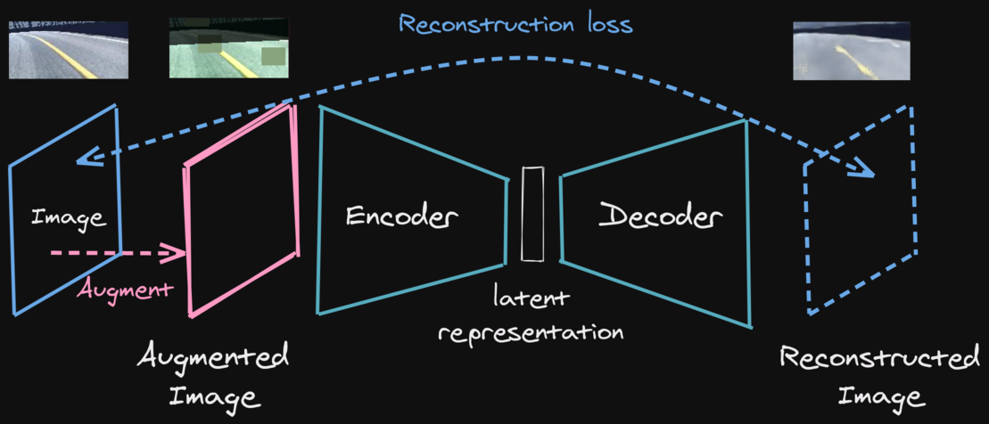
Using Autoencoders In Reinforcement Learning
Train an autoencoder on manually collected road images
When training an RL model:
Take the raw RGB image and compute its latent representation
Use that as the observation, eliminating unnecessary data
Notes:
Now that facts of autoencoder are established.
How does it fit in with the reinforcement learning process?
First, road images are manually collected by driving around in the simulator with an Xbox controller
Then train an autoencoder with those road images
Now, when running reinforcement learning, run the road image through the encoder, and use that as the observation

Slide 12
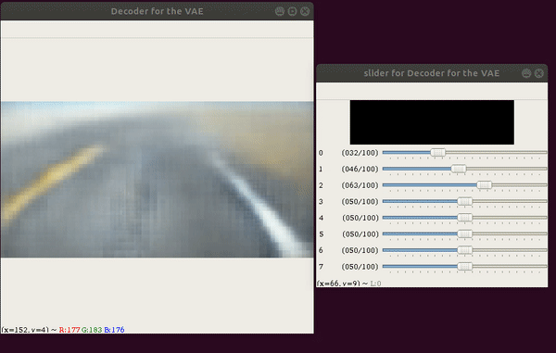
Using Autoencoders In Reinforcement Learning
Train an autoencoder on manually collected road images
When training an RL model:
Take the raw RGB image and compute its latent representation
Use that as the observation, eliminating unnecessary data
Notes:
Here is what happens when you look at 8 of the 32 variables in the latent representation
Notice how changing them affects what the road’s curvature and direction are

Slide 13
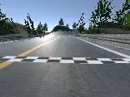
Improved Reinforcement Learning
New input: latent vector (32 numbers) + speed of vehicle
Change policy from CNN to simple MLP
Switch from PPO algorithm to TQC
Adds random noise to action space early on, creates more robust policy
Notes:
In my implementation of reinforcement learning in simulation, the latent vector consists of 32 numbers.
I add on the speed of the vehicle, so the observation is a vector of length 33
Since the input is so much smaller, the underlying policy neural network was changed from a convolutional neural network to a much simpler multi-layer perceptron w/ single hidden layer
Finally, I switched from the PPO algorithm to an algorithm known as TQC (Truncated Quantile Critics). To put it simply, TQC improves on PPO by creating a more robust policy

Slide 14
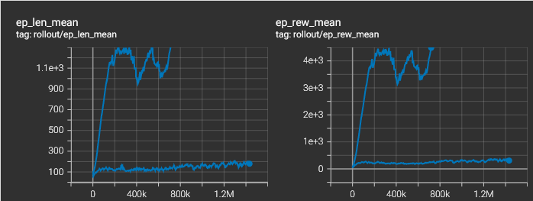
Reinforcement learning results
Left: Time before a crash (seconds)
Right: Reward received by the car agent
Top line is trained with the autoencoder, while bottom is without.
Time Before Collision (s)
Training Timestep
Notes:
With these improvements, the results were much better
In these graphs the lower line represents the original reinforcement learning with PPO while the top line is using the auto-encoder.
With less training, the episode length (left graph), or time before a crash, increased from roughly 150 seconds, or 2 and half minutes
To over 15 minutes before a crash.

Slide 15
Part 2: Miniature Self-driving car
Notes:
Onto part 2, which was building a real self-driving car

Slide 16
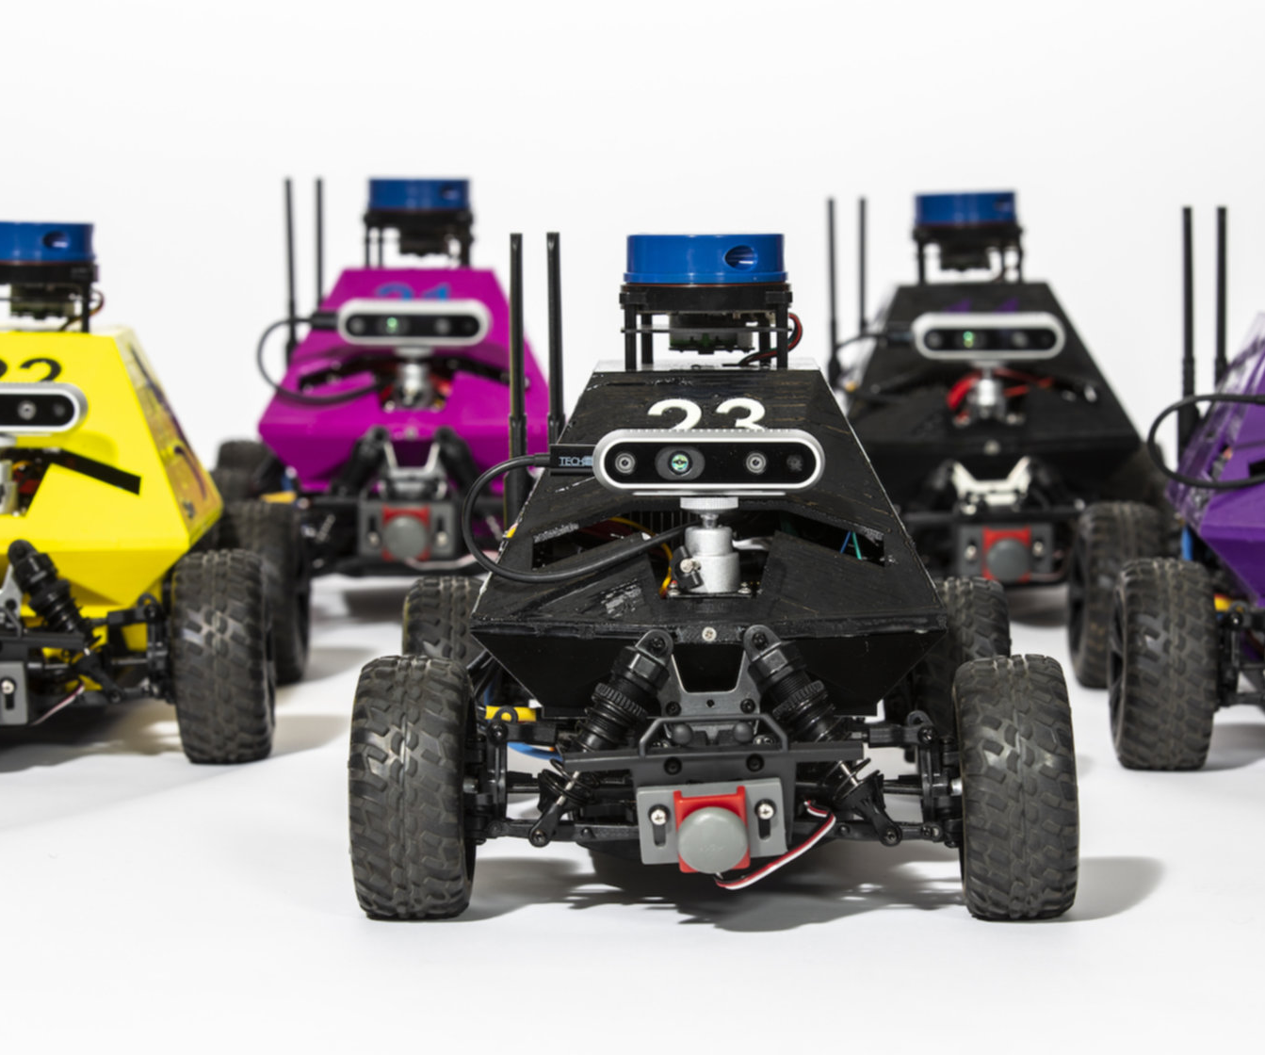
Why build a scaled-down model?
Real cars are expensive and dangerous
1/10 scale cars are:
Relatively inexpensive
Easy to prototype with
A good approximation of real cars
A collection of 1/12 scale autonomous vehicles from the University of Washington
Notes:
First of all, why isn’t simulation enough? Why is a real car necessary?
Well, simulations are just a model of reality. For instance, the specific simulator I used to do the reinforcement learning experiments doesn’t incorporate tire slip
On the other hand, another simulator does incorporate a tire slip model, but doesn’t let users take pictures from the car’s perspective
With a real car, you can drop all the assumptions
However, real cars are extremely expensive and dangerous. Thus, scaled-down cars are a good intermediary between simulations and cars on the road
They’re cheap and replaceable, which is a bonus

Slide 17
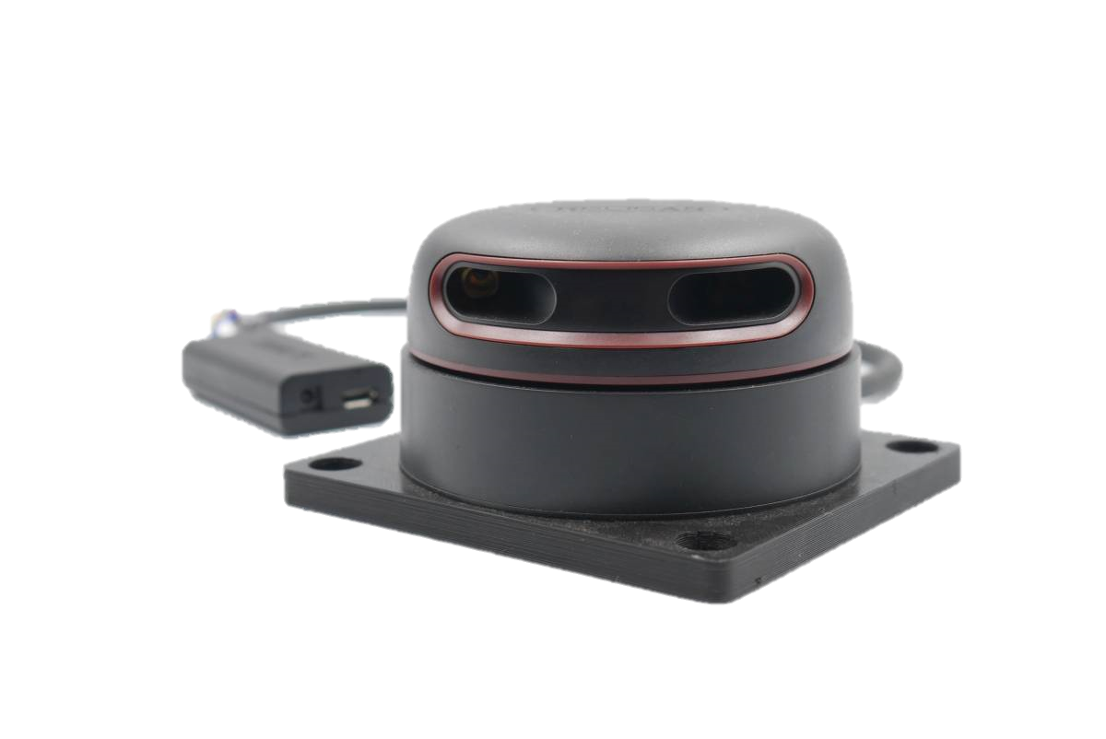
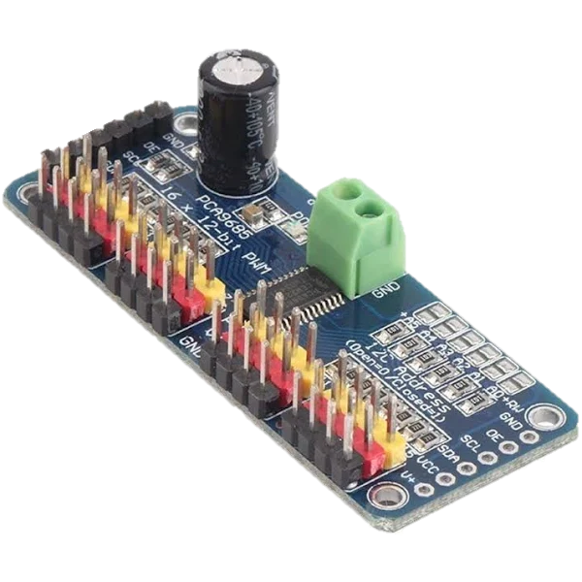
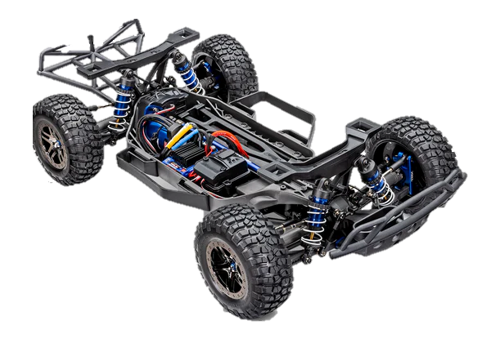
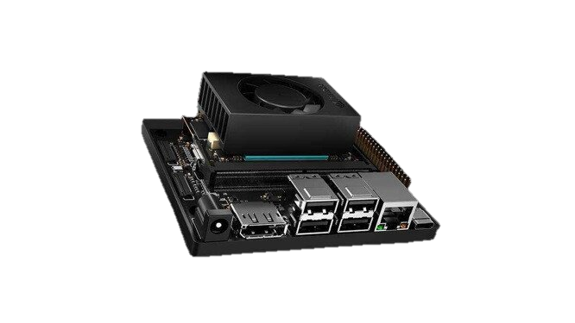
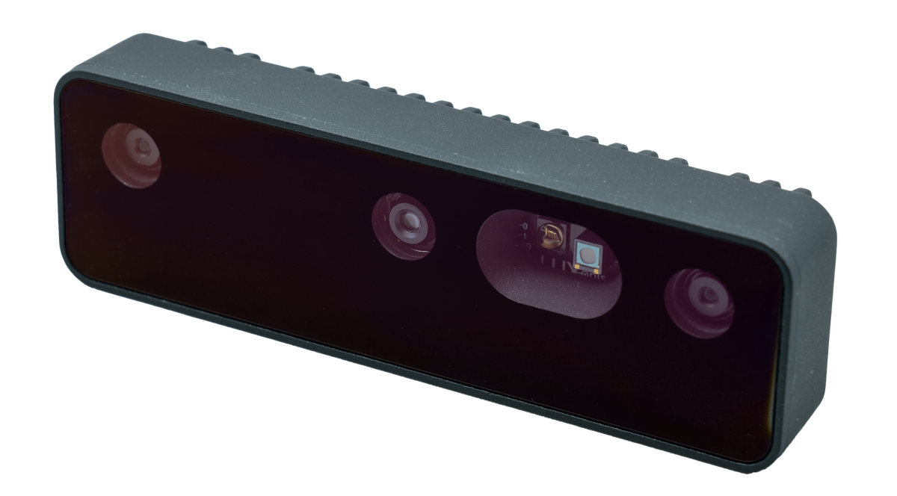

Main components
Notes:
Here’s an overall architecture of how the system works
On the left is the chassis of the car itself. It contains steering servo motor, and electronic speed controller to control throttle motor
A Nvidia Jetson Orin Nano single-board computer takes in sensor data from the lidar sensor and OAK-D camera.
It then processes this information and provides actuation commands to the PCA9685 I2C multiplexer which is connected to the electronic speed controller and servo motor
The Jetson and peripheral electronics are powered off of one battery while the throttle motor is powered by its own separate battery.

Slide 18
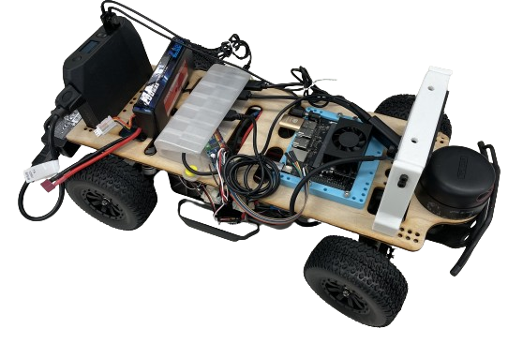
Finished Vehicle
Challenges:
Integrating ESC (Electronic Speed Controller) in a programmable way
Managing limited space on the chassis
Ensuring data was received by the Nvidia Jetson in a usable format
Notes:
Here’s a picture of the finished vehicle.
It was challenging to incorporate the electronic speed controller. I planned on interfacing with it through an Arduino communicating over USB but there was too much latency

Slide 19
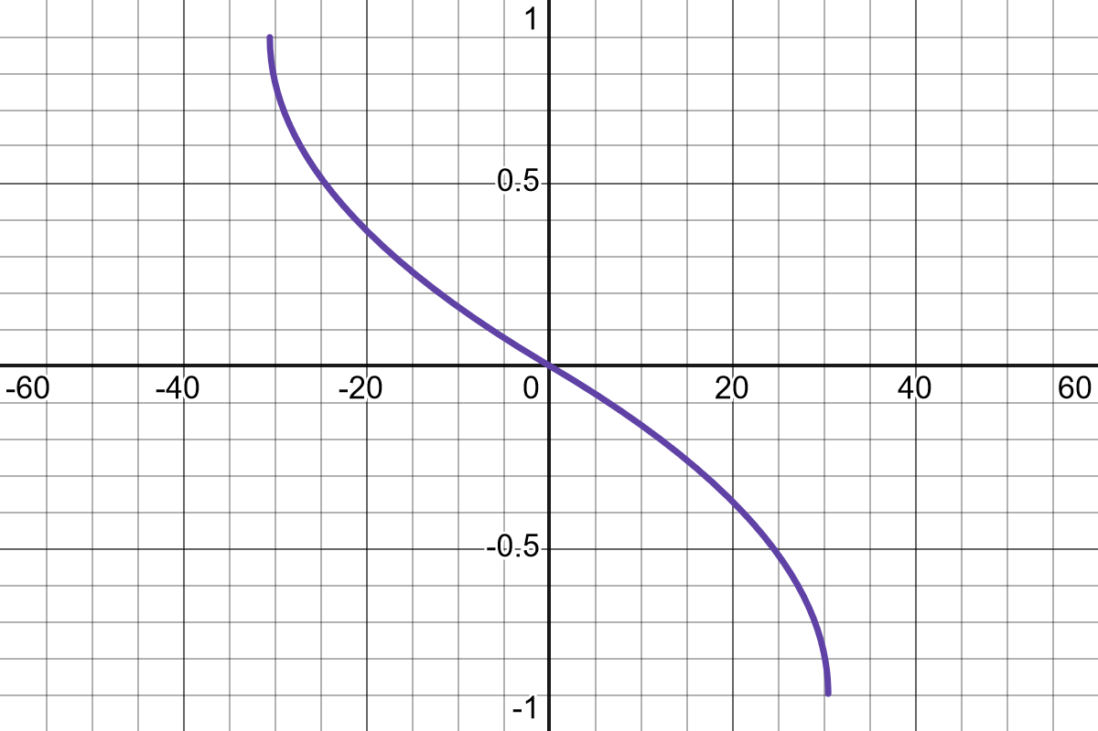
Simulation vs. Reality
Simulation: Input is steering as an angle (radians) and throttle as velocity (m/s)
Reality: Both steering and throttle are arbitrary values between [-1, 1]. -1 is left/backwards while 1 is right/forwards.
Top: Measured steering values vs. true steering angle.
Bottom: True steering angle vs. steering input required.
Notes:
To account for the physical characteristics of the car, I performed measurements to account for the differences.
For one, the simulation I use which incorporates lidar scans controls the car’s steering through an angle in degrees
On the other hand, the real car is steered with a value from -1 to 1. So, we need to translate between these two.
To do this, I attached a laser range-finder to the wheel of the car and commanded it to turn to “0.1”, “0.25”, “0.5”, and 1. Using trigonometry I calculated the angle the wheel was turned
This gives me a function which converts from steering value to steering angle
But, I need the inverse function
Below in the white graph is the inverse function. Converts from steering angle to value. Thus, I can use the same algorithms I used in simulation.

Slide 20
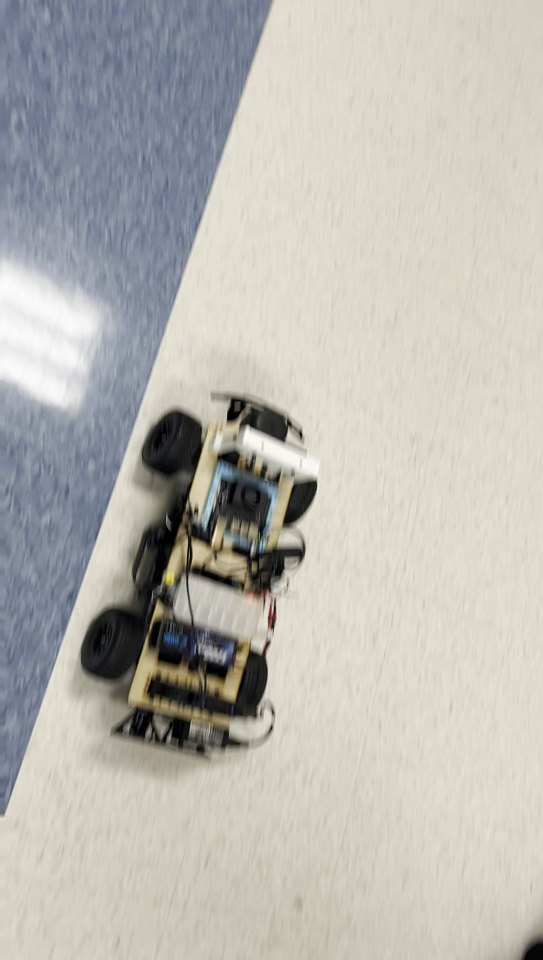
Implementing Wall Following
Wall Following
Use PID controller to maintain equal distance from left and right wall with LiDAR data
Automatic emergency braking from frontal distance measurements
Notes:
Finally, implemented wall following
This is done through a PID controller. A PID controller, in essence, tries to minimize the error between the desired value and the actual value of a variable
Minimizes the error itself, as well as accumulated error (integral term) and rate of change of error (derivative term)
(Video)
I use the PID controller to steer the car based on the distance between the left of the car and right of the car. Goal is that the difference in those distances is 0.

Slide 21
Questions?
Notes:
That concludes my presentation. Do you have any questions?

